Slide 1
Weekly Report
29-07-2024 to 05-08-2024
Roywin Joel Monteiro

Slide 2
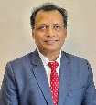


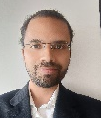


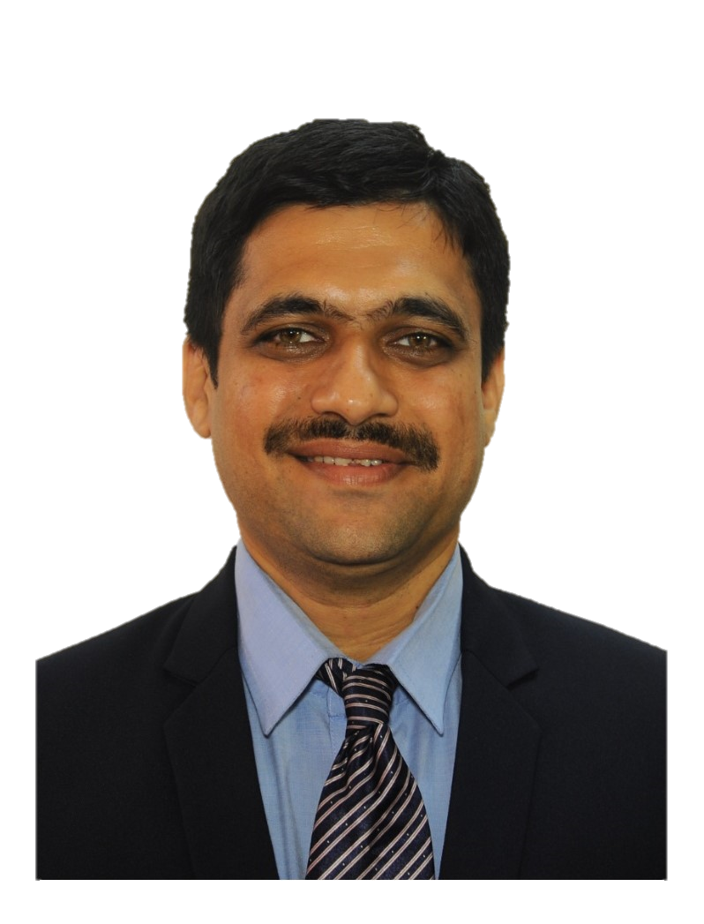
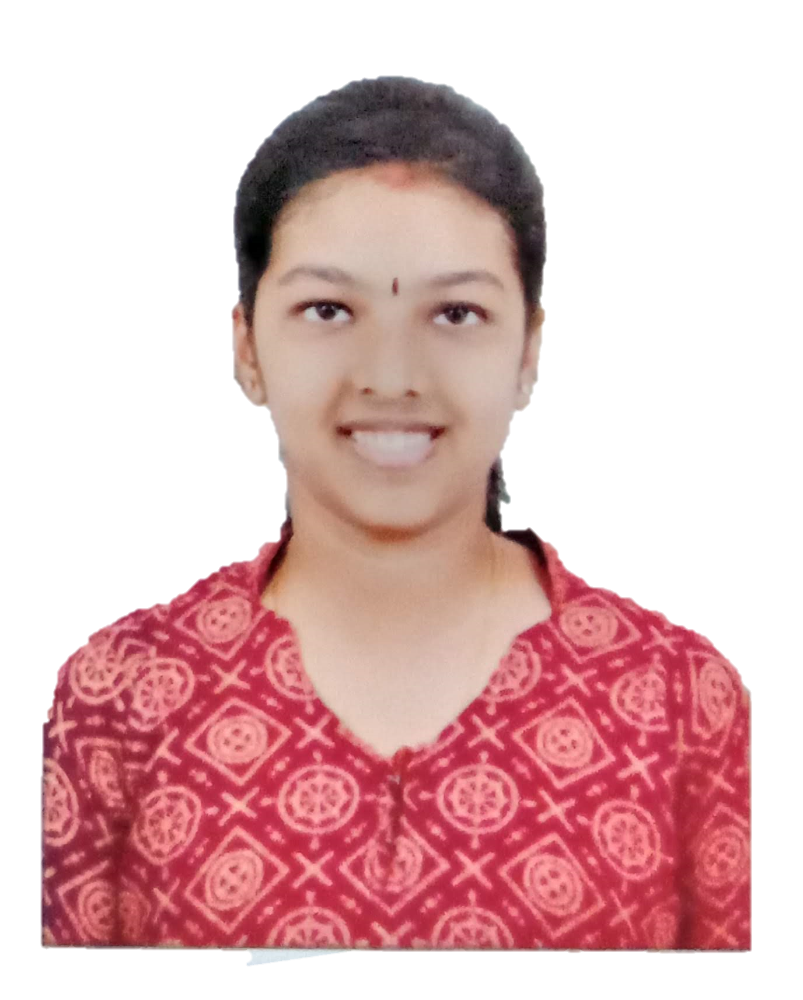
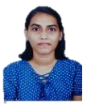
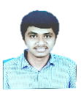


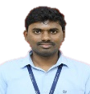
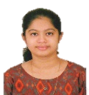
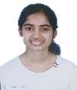


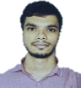
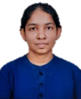
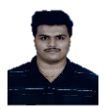



xEV Simulation Software -Organization Chart: NATI
🅱️
Dr. Jayanth Kumar
(CEO)
General Manager: 1
Project Manager: 1
Mentor: 2
Team Size: 16
NATC-Team Japan: Naimisha San, Takagi San, Kusuda San
Customers:
1) NATC/NATI -> NSME -> Formula E
2) NATC/NATI -> AISIN
Ⓜ️
🅱️
Takashi Miyasaka
(Vice President)
🅱️
🅱️
Manik Mahapatra
(Senior Project Manager-Motor)
Ayyappa Thalwar
(Project Manager)
️
🅱️
Akash L M
(CSE)
(Team Lead)
🅱️-Bengaluru(6)
Ⓜ️-Mangalore(16)
Simulation/Research Team
Development Team
Project Mentors
Curve Fitting Team
Generative Design Team
Web Dev. Team
C++ Dev. Team
Ⓜ️
🅱️
Girisha
(3D Curve Fitting and Hybrid Design)
Ⓜ️
Ⓜ️
Ⓜ️
Ⓜ️
Kavya Pai
(ISE)
-Report Person
Veenal Dsa
(ISE)
Pratham Pai
(EEE)
Roywin Joel Monteiro
(ISE)
-Report Person
Glenn Elish
Peter
(ECE)
Ⓜ️
🅱️
Ramakrishna
(Generative Design and eVTOL)
Motor Team: Freshers
Ⓜ️
Ⓜ️
Deekshitha Nayak
(ECE)
Ⓜ️
Pratheeksha
(CSE)
Ashwin
Kamath
(ECE)
Vishwakeerthi Bhat M
(EEE)
-Report Person
Prathik Kamath
(EEE)
Ⓜ️
Ⓜ️
Desktop Dev. Team and Testing Team
CSE-Computer Science Engr.
ISE-Information Science Engr.
ECE-Electronics & Comm. Engr.
EEE-Electrical & Electronic Engr.
MCA- Master of Computer Appl.
Deepali
(CSE)
Ⓜ️
Ⓜ️
Ⓜ️
Ⓜ️
Shreyas S Rao
(ECE)
Pratham Nayak
(EEE)
Prashasth
Naik
(ISE)
K Nachith
Kumar
(MCA)

Slide 3
Roadmap
Design items | April 2024 | May 2024 | June 2024 | July 2024 | Aug 2024 | Sept 2024 | Oct 2024 | Nov 2024 | Dec 2024 | Jan 2025 | Feb 2025 | March 2025
MATLAB + Generative Design
Dash Web App
PyQt Desktop App
Generative AI (C#)
Matlab v6.x to python conversion
1st release
2nd release
Version 6.0
Version 6.0
Version 6.0
Version x

Slide 4
Weekly Status Report (xEV Simulator)
Highlights of last week
Performed Bug Identification and fixing
Replacing the Introduction tab with a Help button
Resolved a bug in the Input tab that caused the entire page to reload when clicking the save button
Conducted research on Wt, a web framework for C++
Started the implementation of generative design in C#
Knowledge Transfer session conducted by the GATS team on the PCL Test document
Support Required | PIC | Remarks
 | Dr. Jayant, T.Miyasaka, Ayyappa T
Issues & Concerns
Workplan for this week
Bug Identification and fixing

